Slide 1
ODU vs VT Football fun
Naga Vamsi Krishna Pabbisetty
April-03-2019

Slide 2
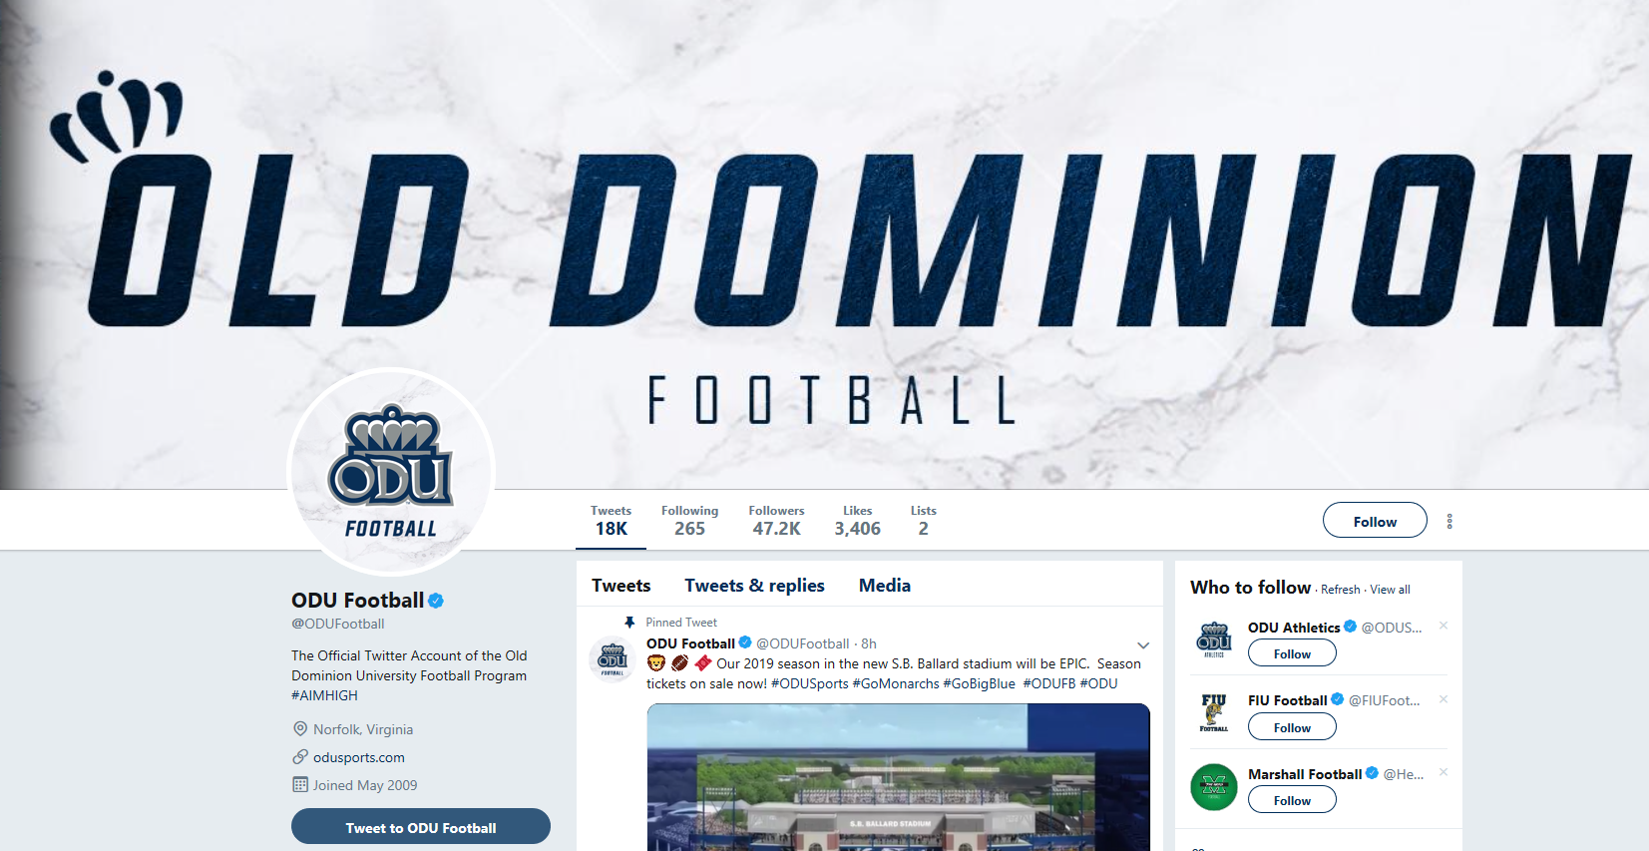
ODU football – Twitter page
https://twitter.com/ODUFootball

Slide 3
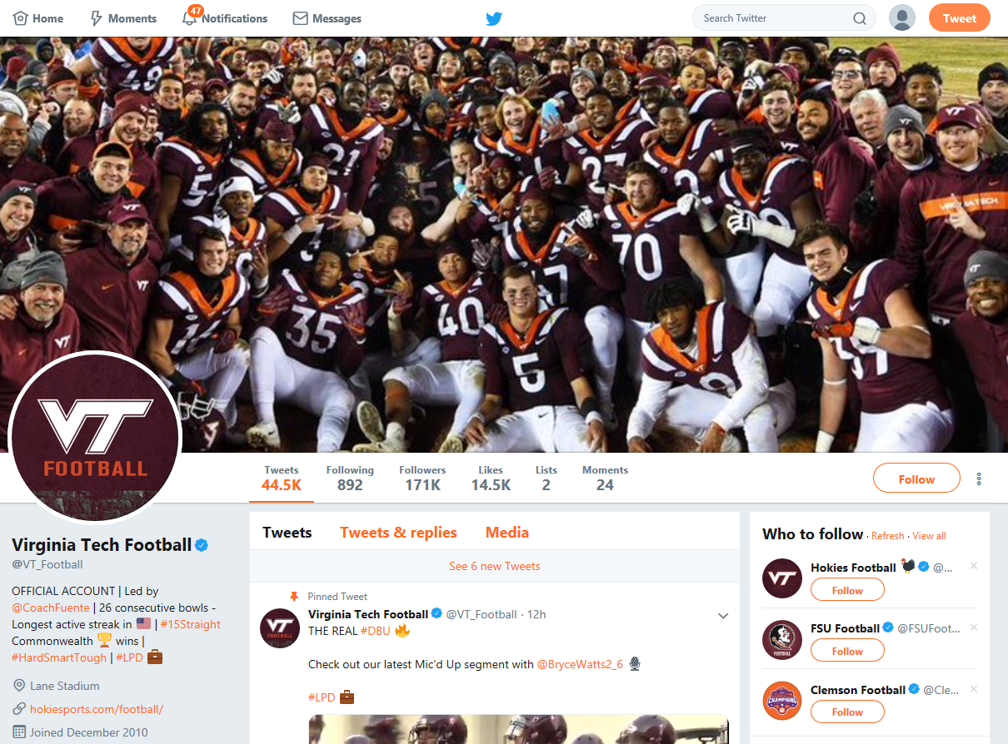
VT football – Twitter page
https://twitter.com/VT_Football

Slide 4
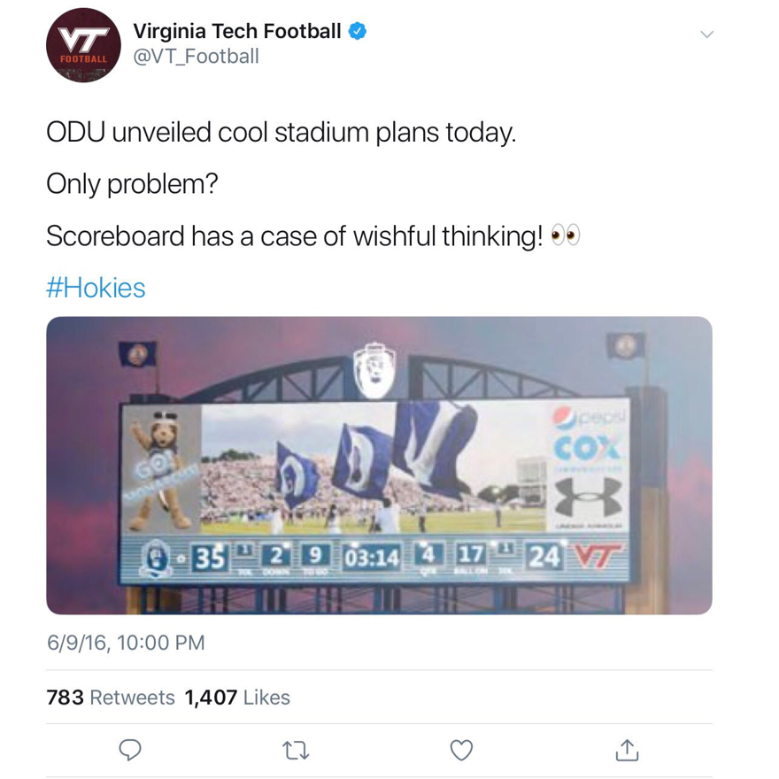
Twitter post by Virginia Tech(VT)

Slide 5
Timeline of events
June 9th 2016
ODU reveals plans for Football stadium with a score board (ODU-35 and VT-24)
June 9th 2016 10 PM
VT makes fun of ODU
Sep 22nd 2018
Tweet resurfaces
ODU wins over VT with a score of 35
Sep 23rd 2018
Trolls on twitter about the old tweet and on VT’s score
After 23rd Sep
VT removes the post from twitter

Slide 6
ODU – New football stadium
June 9th – ODU reveal plans for a new stadium
Seats - 22,130
Approximately 2000 seats more than Foreman Field
55 million dollars budget without increase in student fees
To start by end of 2018 and to complete by 2019
Plans shows a football score board – ODU-35 and VT-24
https://www.nbcsports.com/washington/ncaa/odu-takes-jab-hokies-new-football-stadium-proposal
https://www.odu.edu/news/in-the-news/2016/6/odu_in_the_news_1600904600#.XKNuAphKiUk

Slide 7
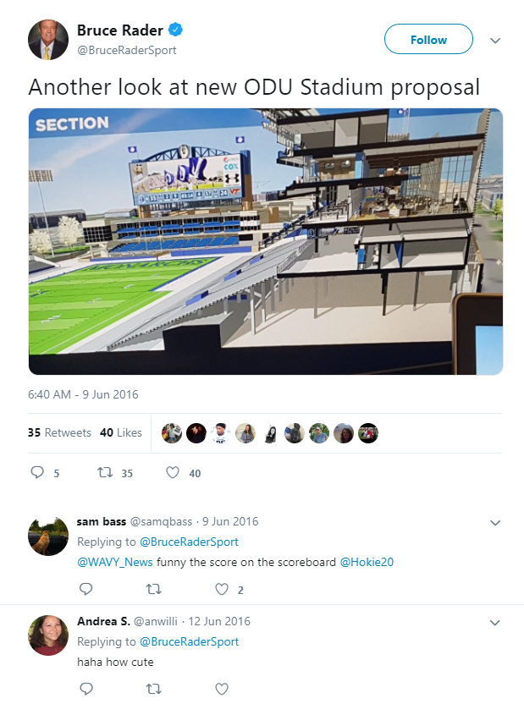
On Twitter
https://twitter.com/BruceRaderSport/status/740901284648214528/photo/1?ref_src=twsrc%5Etfw%7Ctwcamp%5Etwee
tembed%7Ctwterm%5E740901284648214528&ref_url=https%3A%2F%2Fwww.nbcsports.com%2Fwashington%2Fncaa%2Fodu-takes-jab-hokies-new-football-stadium-proposal

Slide 8
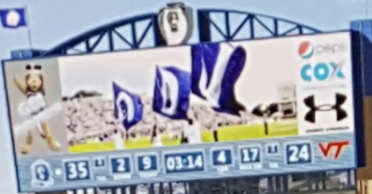
Closer look at the score board
https://twitter.com/BruceRaderSport/status/740901284648214528/photo/1?ref_src=twsrc%5Etfw%7Ctwcamp%5Etwee
tembed%7Ctwterm%5E740901284648214528&ref_url=https%3A%2F%2Fwww.nbcsports.com%2Fwashington%2Fncaa%2Fodu-takes-jab-hokies-new-football-stadium-proposal

Slide 9
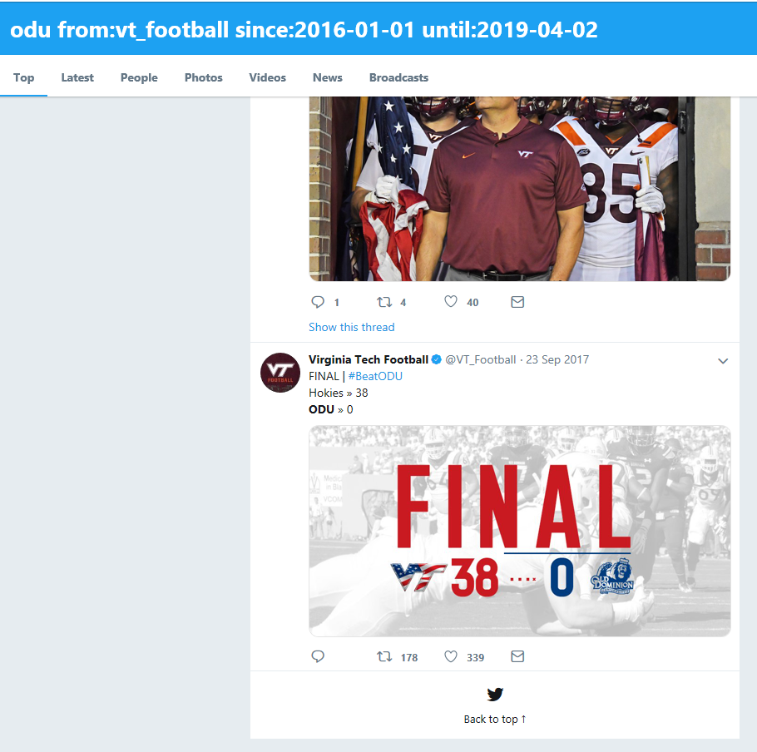
No longer on Twitter – Twitter advanced search

Slide 10
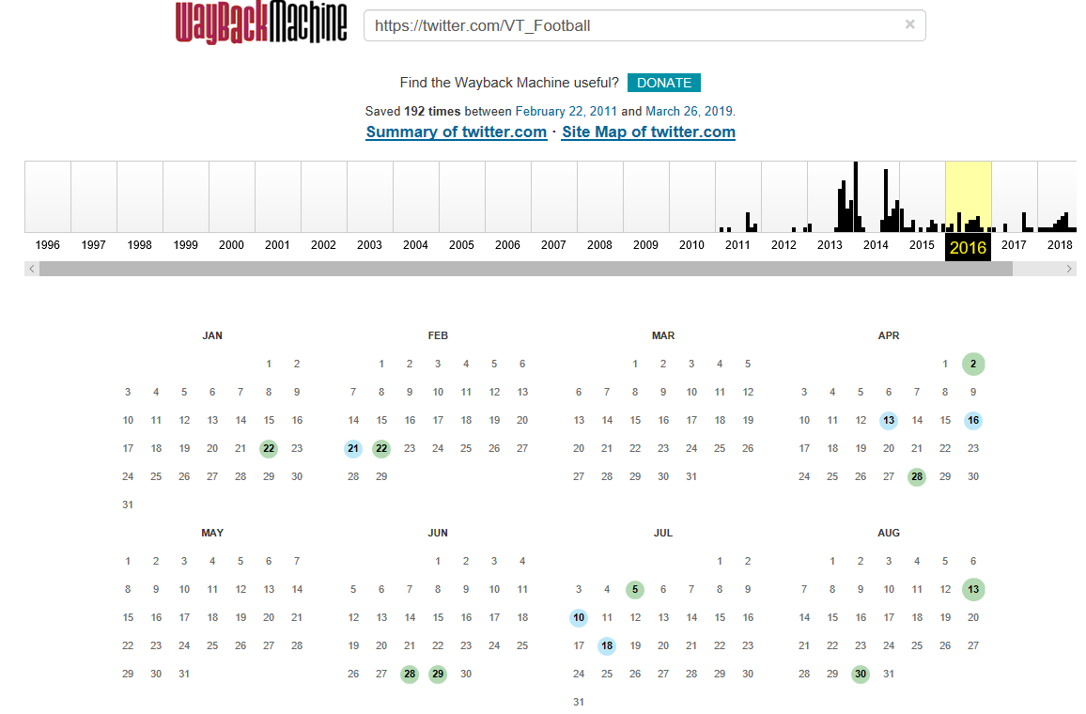
WayBack Machine – VT_Football
https://web.archive.org/web/20160615000000*/https://twitter.com/VT_Football

Slide 11
Memgator – VT_Football
npabbise@sirius:~$ curl https://memgator.cs.odu.edu/memento/link/20130326132726/https://twitter.com/VT_Football
<https://twitter.com/VT_Football>; rel="original",
<http://wayback.archive-it.org/all/20110401024930/https://twitter.com/VT_Football>; rel="first memento"; datetime="Fri, 01 Apr 2011 02:49:30 GMT",
<http://wayback.archive-it.org/all/20111117131910/https://twitter.com/VT_Football>; rel="prev memento"; datetime="Thu, 17 Nov 2011 13:19:10 GMT",
<http://web.archive.org/web/20130116040228/https://twitter.com/VT_Football>; rel="memento"; datetime="Wed, 16 Jan 2013 04:02:28 GMT",
<http://wayback.archive-it.org/all/20131009083355/https://twitter.com/VT_Football>; rel="next memento"; datetime="Wed, 09 Oct 2013 08:33:55 GMT",
<http://wayback.archive-it.org/all/20190326194657/https://twitter.com/VT_Football>; rel="last memento"; datetime="Tue, 26 Mar 2019 19:46:57 GMT",

Slide 12
No references to ODU in the last available memento
npabbise@sirius:~$ curl http://wayback.archive-it.org/all/20190326194657/https://twitter.com/VT_Football | grep ODU
% Total % Received % Xferd Average Speed Time Time Time Current
Dload Upload Total Spent Left Speed
100 663k 100 663k 0 0 621k 0 0:00:01 0:00:01 --:--:-- 621k

Slide 13
2018 Sep 22 – ODU vs VT
Foreman Field
VT’s first play at ODU
ODU score 49 and VT score 35
VT’s score reflects ODU’s score (as in the plans for new stadium)
Twitter trolls VT for the old tweet in 2016

Slide 14
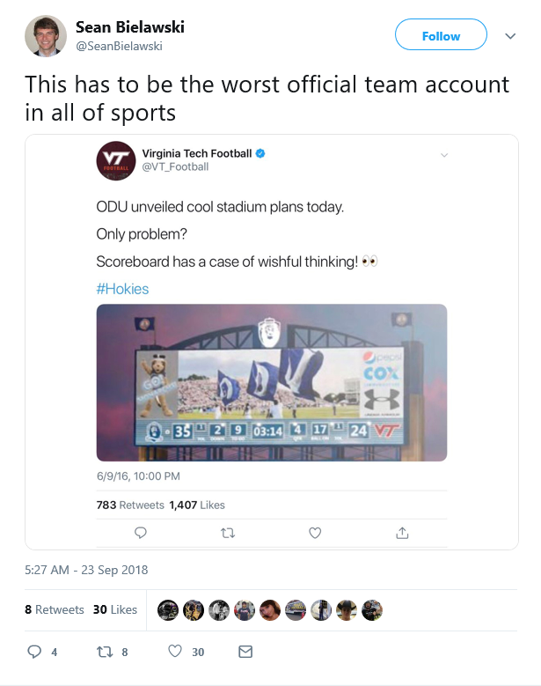
Old tweet resurfaces
https://twitter.com/SeanBielawski/status/1043839282534862848

Slide 15
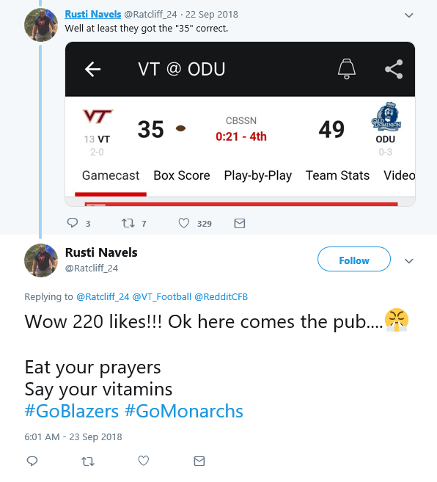
Troll tweets on VT scoring “35”
https://twitter.com/Ratcliff_24/status/741223084477288448/photo/1?ref_src=twsrc%5Etfw%7Ctwcamp%5Etweetembed%7
Ctwterm%5E1043691086487736321&ref_url=https%3A%2F%2Fsportsnaut.com%2F2018%2F09%2Ffans-roast-virginia-tech-over-old-tweet-trolling-old-dominion%2F

Slide 16
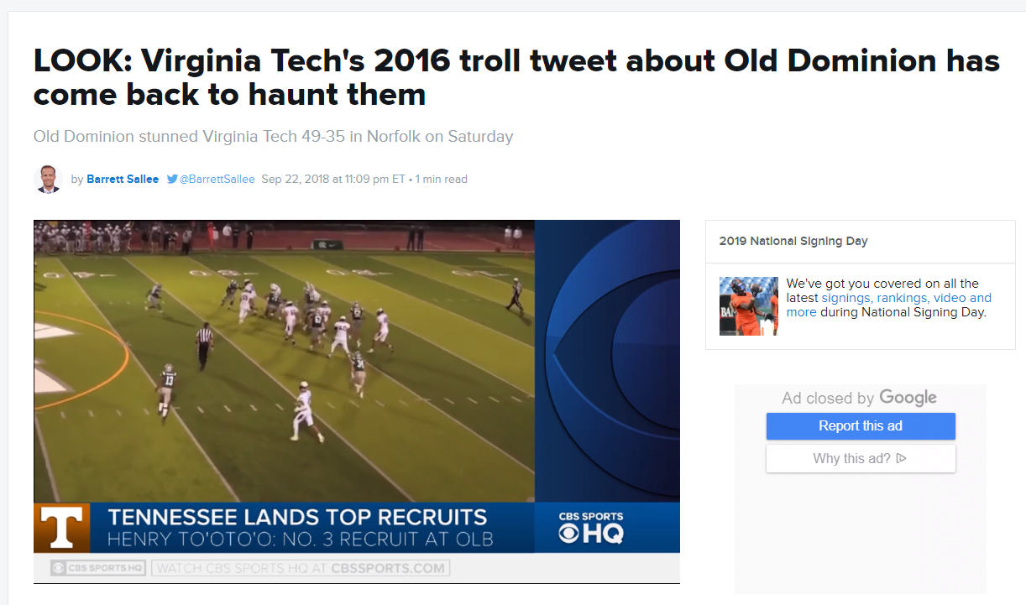
Sports news on VT
https://www.cbssports.com/college-football/news/look-virginia-techs-2016-troll-tweet-about-old-dominion-has-come-back-to-haunt-them/

Slide 17
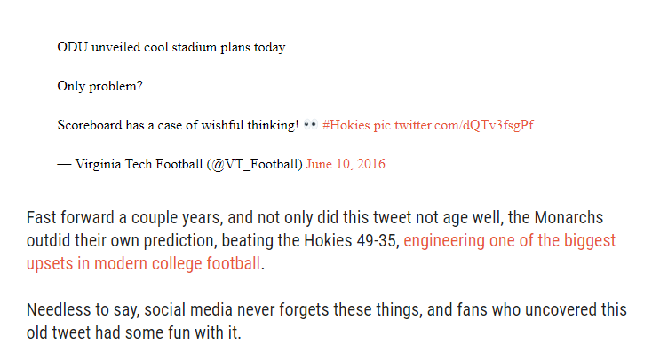
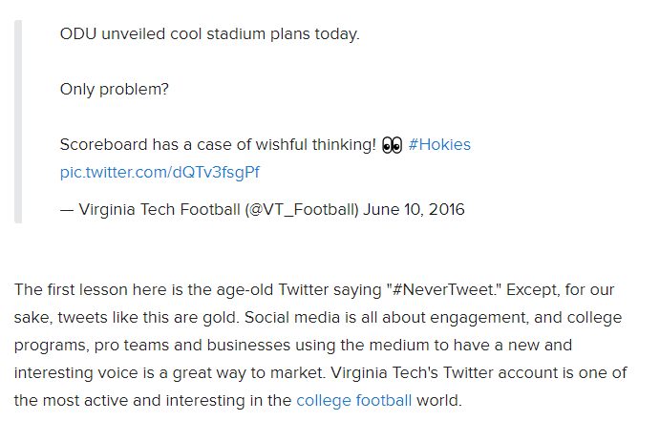
Sports news about the old troll tweet
https://www.cbssports.com/college-football/news/look-virginia-techs-2016
-troll-tweet-about-old-dominion-has-come-back-to-haunt-them/
https://sportsnaut.com/2018/09/fans-roast-virginia-tech-over-old-tweet-trolling-old-dominion/

Slide 18
Link of the actual twitter post from different media sources
Link of the actual tweet - https://twitter.com/VT_Football/status/741087562127679488/photo/1
Sources:
npabbise@sirius:~$ curl https://memgator.cs.odu.edu/memento/link/20130326132726/https://www.cbssports.com/college-football/news/look-virginia-techs-2016-troll-tweet-about-old-dominion-has-come-back-to-haunt-them/
<http://web.archive.org/web/20180923113610/https://www.cbssports.com/college-football/news/look-virginia-techs-2016-troll-tweet-about-old-dominion-has-come-back-to-haunt-them/>; rel="first last memento"; datetime="Sun, 23 Sep 2018 11:36:10 GMT",
https://sportsnaut.com/2018/09/fans-roast-virginia-tech-over-old-tweet-trolling-old-dominion/ -- No mementos present
https://www.cbssports.com/college-football/news/look-virginia-techs-2016-troll-
tweet-about-old-dominion-has-come-back-to-haunt-them/ -- Only one memento present

Slide 19
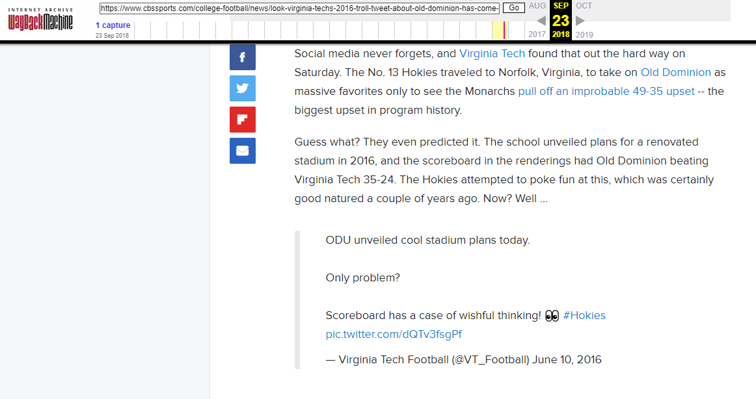
Archive from 2018 – news about old tweet
https://web.archive.org/web/20180923113610/https://www.cbssports.com/college-football/news/look-virginia-techs-2016-troll-tweet-about-old-dominion-has-come-back-to-haunt-them/

